Slide 1
Feedback form for passed out students.
Team number:3
Team guide: G.Shankar Rao sir.
Team members:
P.S.Priya
S. Swathi
Y. Pavani
N.S.V.M.Sindhuja

Slide 2
Abstract of the project
Usually, the feedback form collected by our college from the alumni every year is in the form of hardcopy.
There is a difficulty to fill and collect these forms from both alumni side as well as college administration side.

Slide 3
Continution..
So , making this form online helps both administration side and alumni side.
The alumni, no longer come to college and fill the hard copy forms , rather share their feedback with our college through this webportal online.

Slide 4
Theme of this project
This project is an online webpage which facilitates alumni to fill the feedback form of our college online.
The alumni are sent a link to their email ids.
Alumni access this page and login to webpage.
The login page is directed to the feedback to be filled.
The admin also retrieves the data of passed out students by logging in this webpage.

Slide 5
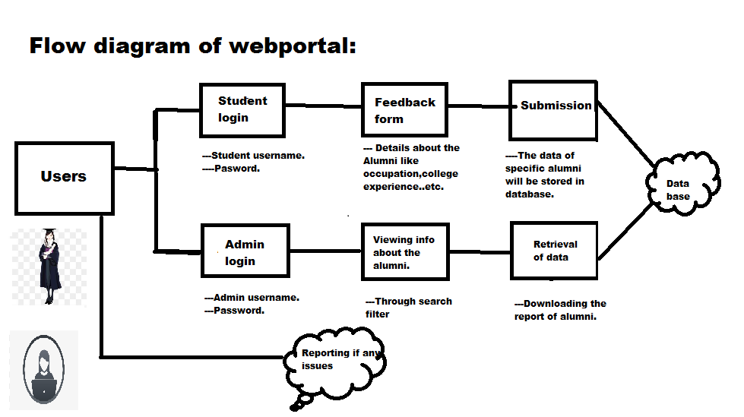

Slide 6
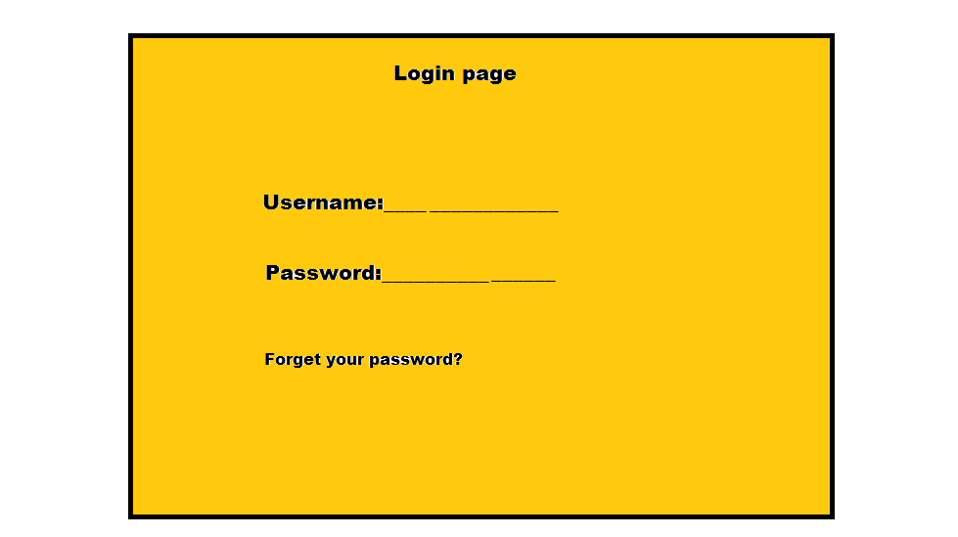
Login page credentials:
1.For alumni login,Username is domain email id and password is their pass-
-word issued by our college.
2.Admin login will have separate userid and password set by the college.

Slide 7
Feed back form details:
After alumni logged in, she has to fill the information about her details like:
working in job or going to higher studies.
If job, the details of the job
And other preliminary information about them like
email id,contact number,current address.
Feedback about the classroms,faculty,labs,hostels(if hostler..) ..etc.
This submitted data is stored in database.

Slide 8
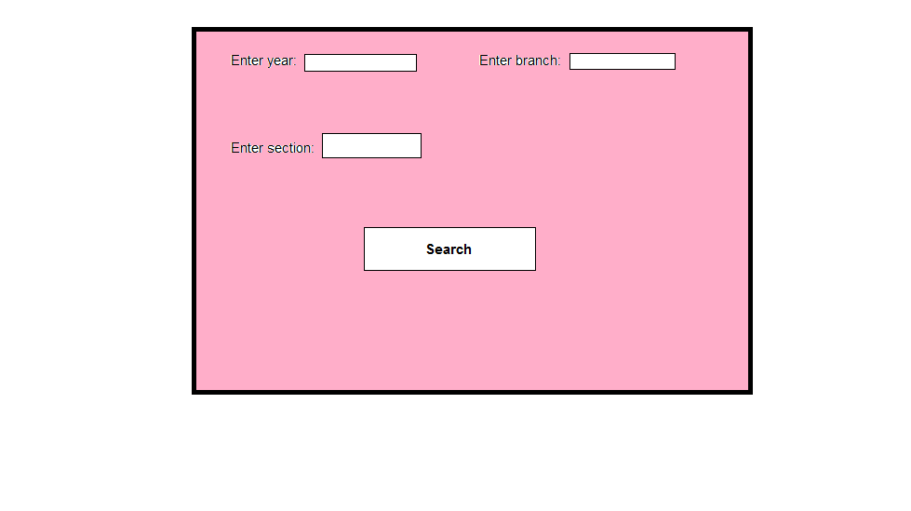
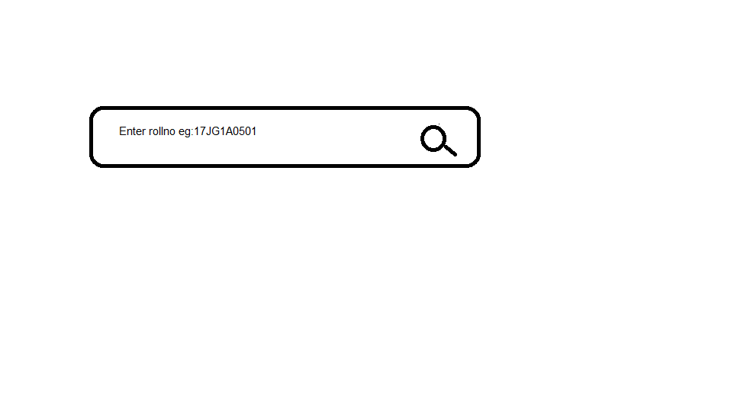
Administrators side
So the data collected is not accessible by any other in the college except admin.
The admin retrieves the data by filtering database with search filter.
The filtering can be done based on rollno or year, branch , section.

Slide 9
Thank you

